Slide 1
CIS CONTROL 17: SECURITY AWARENESS & TRAINING-II
IMPLEMENT A SECURITY AWARENESS & TRAINING PROGRAM

Slide 2
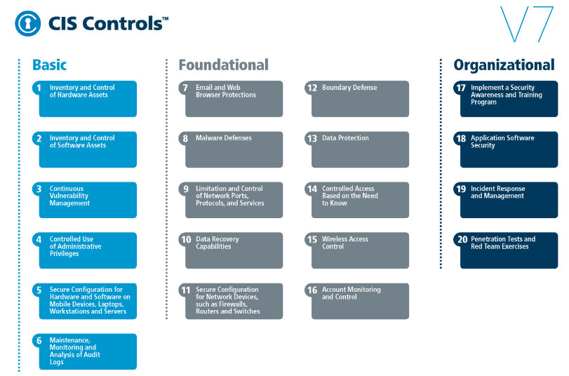
CIS CONTROL 17: SECURITY AWARENESS & TRAINING-II
https://www.cisecurity.org/controls/

Slide 3
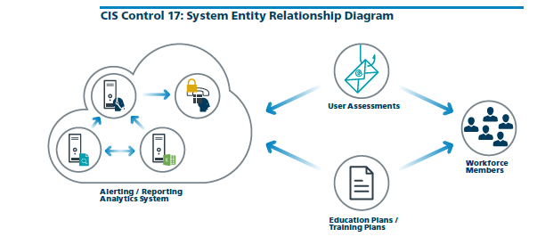
CIS CONTROL 17: SECURITY AWARENESS & TRAINING-II
https://www.cisecurity.org/controls/

Slide 4
CIS CONTROL 17: SECURITY AWARENESS & TRAINING-II
17.5: Train Workforce on Secure Authentication
Train workforce members on the importance of enabling and utilizing secure authentication.

Slide 5
CIS CONTROL 17: SECURITY AWARENESS & TRAINING-II
17.6: Train Workforce on Identifying Social Engineering Attacks
Train the workforce on how to identify different forms of social engineering attacks, such as phishing, phone scams and impersonation calls.

Slide 6
CIS CONTROL 17: SECURITY AWARENESS & TRAINING-II
17.7: Train Workforce on Sensitive Data Handling
Train workforce on how to identify and properly store, transfer, archive and destroy sensitive information.

Slide 7
CIS CONTROL 17: SECURITY AWARENESS & TRAINING-II
17.8: Train Workforce on Causes of Unintentional Data Exposure
Train workforce members to be aware of causes for unintentional data exposures, such as losing their mobile devices or emailing the wrong person due to autocomplete in email.

Slide 8
CIS CONTROL 17: SECURITY AWARENESS & TRAINING-II
17.9: Train Workforce Members on Identifying and Reporting Incidents
Train employees to be able to identify the most common indicators of an incident and be able to report such an incident.
END

